Slide 1
SURE
SECURITY
THERMAL CAMERAS

Slide 2
DISCLAIMER
SURE Security Products are not designed to diagnose diseases such as coronavirus, H1N1, SARS, or influenza. SURE Security is not advertising products for use in the medical industry or for medical purposes. Thermal products can identify individuals in a population that displays a higher temperature.
Thermal cameras do not find individuals experiencing coronavirus symptoms. There is no way to thermally detect an infected individual who has a normal body temperature.
Only a licensed medical professional can determine if a warm individual has a medical condition.
SURE Security products are not sold or marketed for any medical use.

Slide 3
Notes
Celsius is used throughout this presentation, but all products can also operate in Fahrenheit.
The term 'Organizations' is used to describe businesses, non-profits, government entities and other potential users of thermal cameras.
The term 'Visitors' is used to describe customers, patients, guests, employees, members or other people who will potentially be screened by thermal cameras.

Slide 4
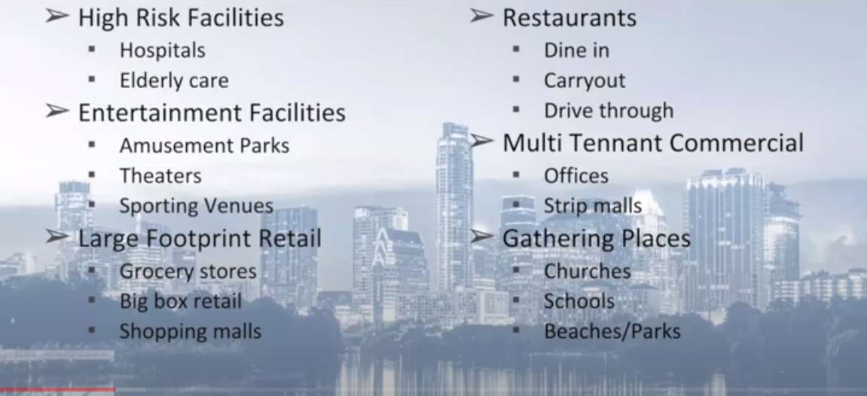
Organizations have different requirements

Slide 5
Introduction
With the Pandemic now in its full swing, new procedures for a safe working environment needs to be put in place to reduce the risk of the spread of the COVID19 virus.
SURE Security has been working towards providing a solution that will notify users of a high temperature as an early warning of a possible fever, which is key in first line defense.
Although this does not specifically tell you that an individual has COVI19, it allows you to investigate with additional testing and deal with the person with a fever before entering the workplace.

Slide 6
Services
Thermal Camera
Network Video Recorder (NVR)
QR Contact Tracing App
Services and equipment can operate as a stand-alone or an integrated solution.

Slide 7
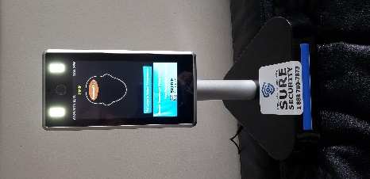
Thermal Body Temperature Camera
The camera can operate as a Stand-Alone Solution
Measure Temperature Detection
Face Mask
Facial recognition
The Thermal camera operates best when integrating and combined with the ACS Network Video Recorder. This will be presented in a separate slide.

Slide 8
Camera Scanning Combinations
The Camera can be setup with any of the combinations, for example
Temperature Only
Mask Only
Facial Recognition Only
Temperature and Mask
Temperature, Mask and Facial Recognition.
If the camera is used as a Facial Recognition, then up to 20,000 people’s faces can be stored on the unit and can operate as an Access Control device.

Slide 9
Other Functions
Trigger
The unit has a relay output for the control of a Door, turnstile, or any electronic device, making it into an Access Control solution for businesses.
Setup
The unit can be setup by using an Internet Browser and logging in with a username and password. Once logged in, there will be access to a host of options, such as IP configurations, temperature thresholds, adding and deleting people etc.
Access
Touchless Door Entry is achieved by connecting the relay output to the Automated Door Opener.

Slide 10
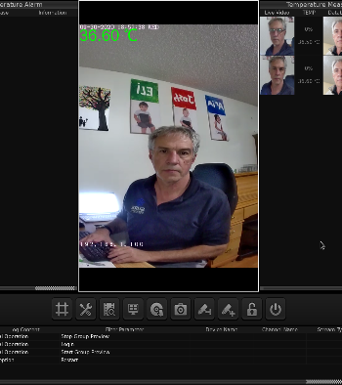
NETWORK VIDEO RECORDER (NVR)
High Temperature alert via email when taking out our maintenance plan.
The camera operates as a normal security camera with 24/7 recording.
The temperature measurement transactions are recorded for reporting purposes which can be used for contact tracing.
Audible notification of High Temperatures in real time from the NVR which allows you to act quickly.
Abnormal temperature Live View
Normal Temperature Live View
Easy Access Control setup using Facial Recognition
Live view of Temperature Readings
Up to 16 Thermal Cameras per NVR

Slide 11
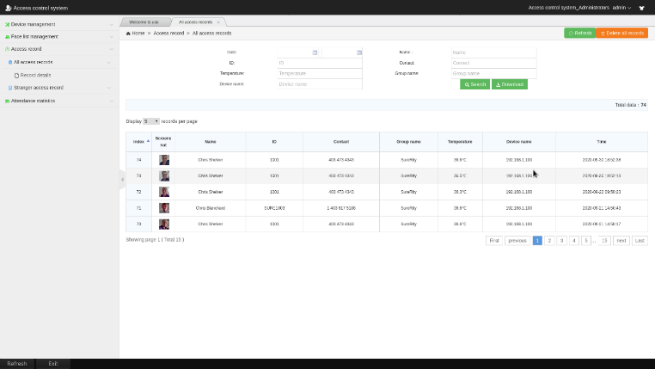
Temperature measure Reporting

Slide 12
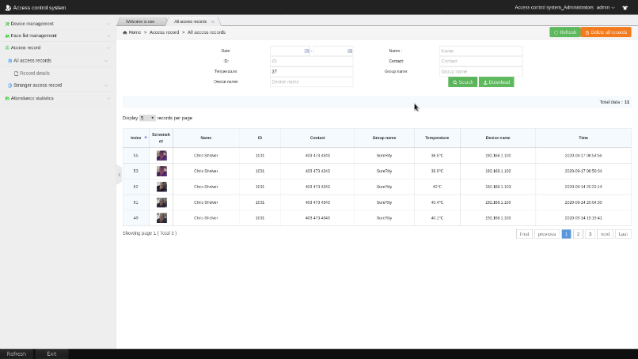
HIGH TEMPERATURE REPORT

Slide 13
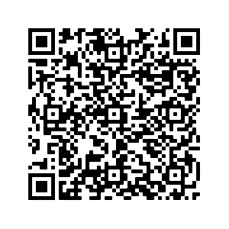
Contact access & tracing system
Cloud based
Industry standard forms solution
Built on leading messaging platform for flexible message and notification routing
Open and secure storage technology
Customizable forms, routing, reporting
Reports extracted to excel for further refinement and analysis
Runs on almost any device
Visitor smartphone access via web or qr code
QR code access

Slide 14
How our solution works
Visitor access declaration form
This form can be tailored to suit your requirements, and can be accessed from virtually any device supporting a modern browser. This includes workstations and tablets installed at visitor entrances, to a visitor’s smartphone (accessed via a QR code).
Routing engine
Once the form is submitted it is evaluated against rules defined by the customer, and routed on wards Options include routing all forms to a specific address, routing forms that have failed checks to specific addresses as a warning, and routing to multiple addresses.
Note that all routing is using Telegram, which allows us to support environments from smartphones to workstations to browsers

Slide 15
How our solution works / 2
Storage
Access and pandemic declaration forms are stored on a database in the cloud and are available for reporting and download until they are aged out based on customer-defined criteria.
Reporting and retrieval
We provide standard reports in both full and summary formats, that can be retrieved on criteria such as date, type of form, visitor name and so on. Reports are downloaded in Excel format so that the user for further formatting, refinement and local storage
Custom reports and search criteria can be developed based on customer’s requirements

Slide 16
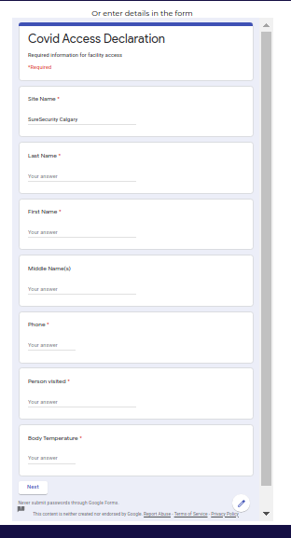
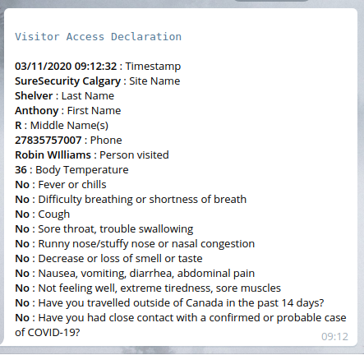
Thermal Cameras only Report the Temperature
1``
QR code
Form
Storage
Access
Analysis and
Reporting
Access
Notification
Message
Access
Form

Slide 17
System roadmap and options
PWA
Visitor and security staff registration web app.
Form routing
Validation / selection of person visited, and notification routing to person visited
Electronic access register and reporting
Extend system to replace manual visitor entry and exit logs

Slide 18
SURE
SECURITY
OFFICE: 888 780 SURE
www.suresecurity.ca

Slide 19
Thermal Cameras only Report the Temperature

